Slide 1
SH2027-XX
Marrow involvement by clonally-related chronic lymphocytic leukemia/small lymphocytic lymphoma (CLL/SLL) and high grade B-cell lymphoma with MYC gene rearrangement
Wenbin Xiao; Umut Aypar; Yanming Zhang; Maria E. Arcila; Mikhail Roshal, Ahmet Dogan; Caleb Ho
Memorial Sloan Kettering Cancer Center, New York, NY

Slide 2
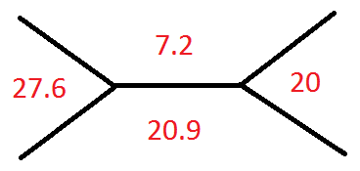
Clinical Information
48 year old male
Previously diagnosed with CLL/SLL in 2006, treated with fludarabine, cyclophosphamide, rituximab, and ibrutinib.
Presented with worsening autoimmune anemia, leukocytosis, and thrombocytopenia with poor response to transfusions, as well as highly elevated LDH and uric acid levels.
MCV: 83 fL
Differential:
Neutrophil: 1.0%
Lymphocytes: 74.0%
Monocytes: 0%
Eosinophils: 0%
Basophils: 0%
Other Atypical cells: 25.0%
LDH: >2000

Slide 3
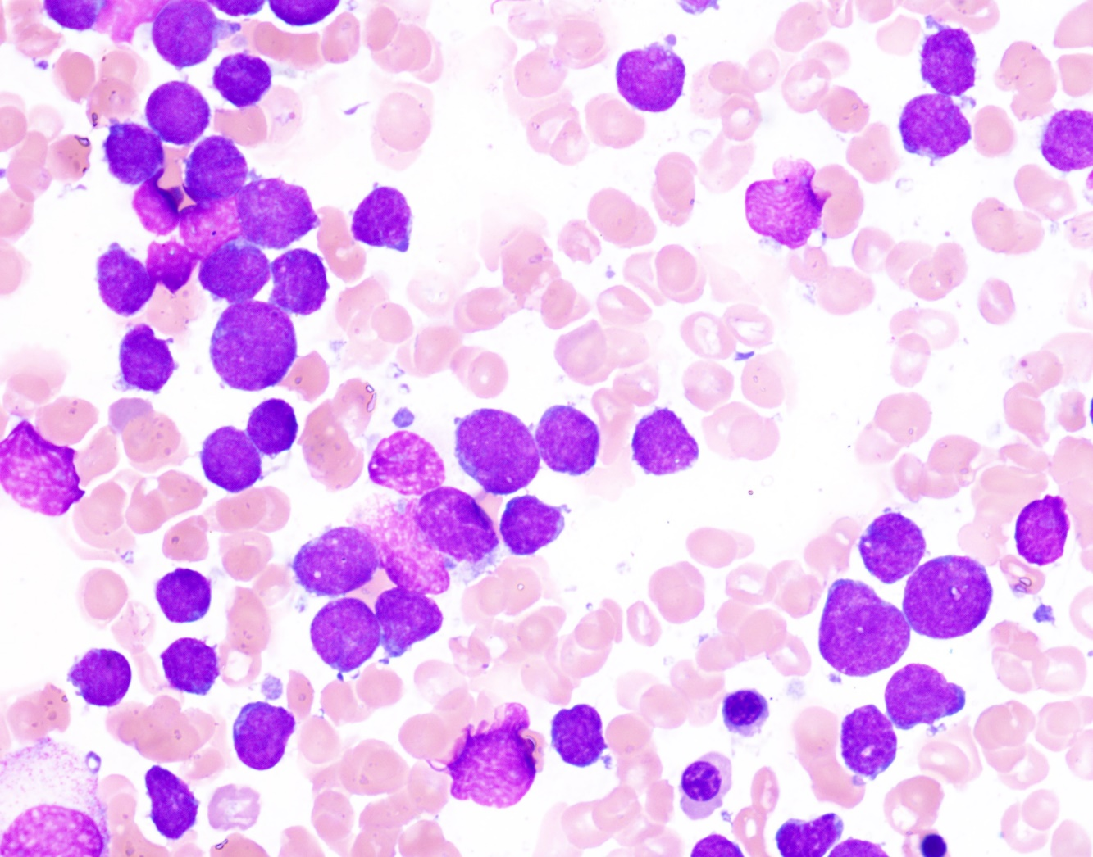
Details of Microscopic Findings
Hypercellular marrow (>95% cellularity), with virtually complete replacement by atypical lymphoid cells.
The majority of the lymphoid cells (~90% of cellularity) are intermediate to large-sized, monotonous appearing, with slightly irregular nuclei, fine to dispersed chromatin, variably distinct nucleoli, and a small amount of cytoplasm.
A small subset of lymphoid cells (~10% of cellularity) are small-sized, monotonous appearing, with round nuclei, clumped to condensed chromatin, indistinct nucleoli, and scant cytoplasm.
WG x1000

Slide 4
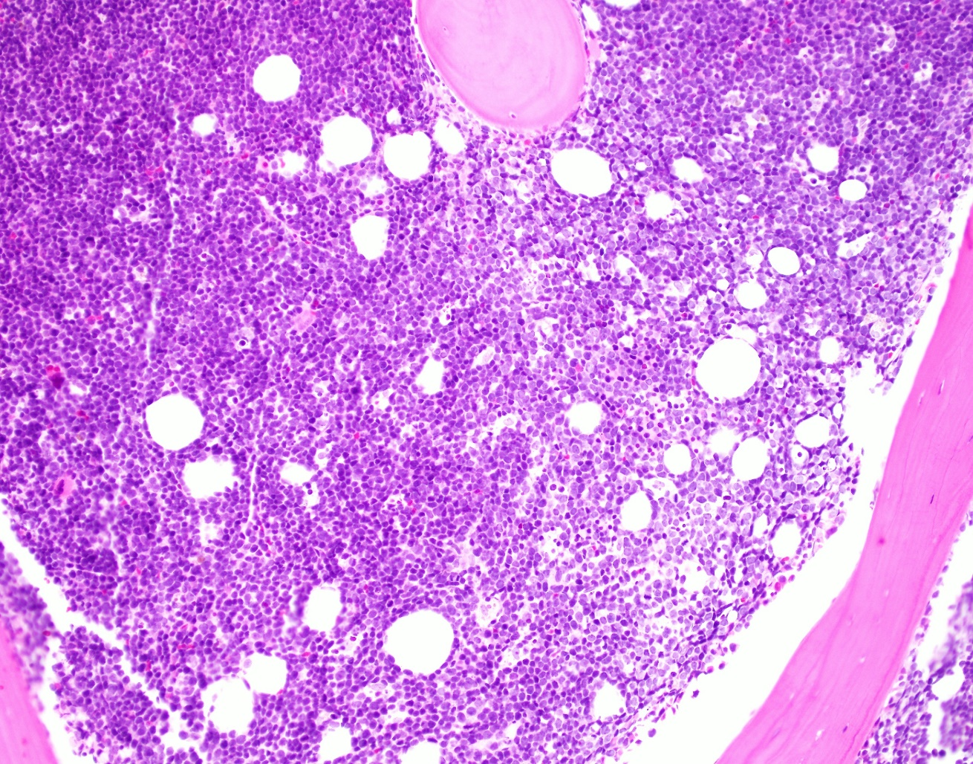
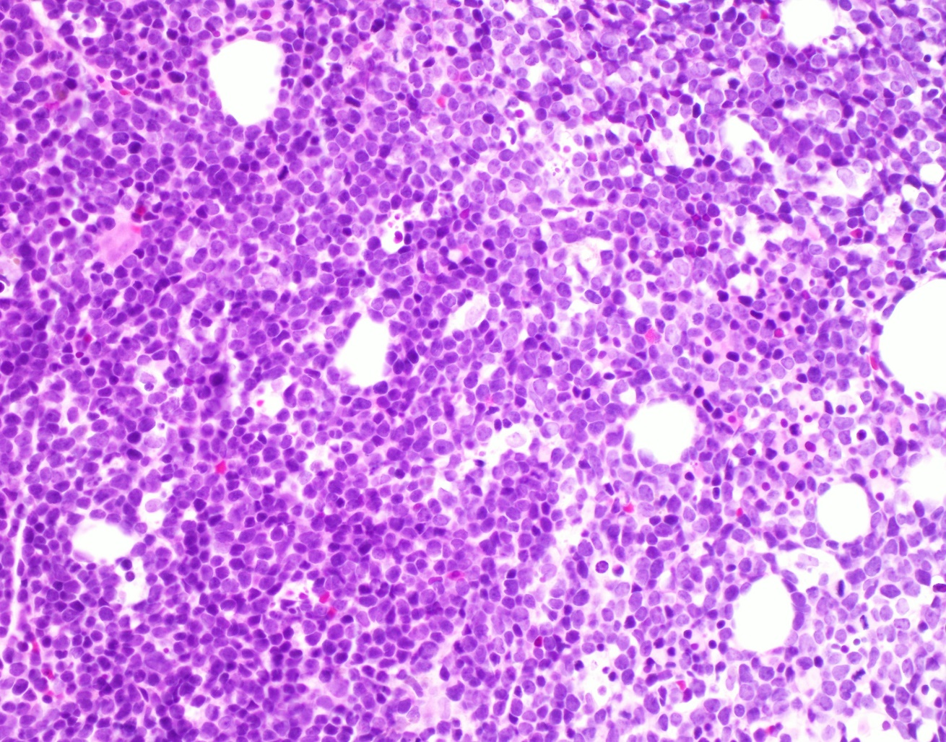
Details of Microscopic Findings-cont’d
H&E x200
H&E x400

Slide 5
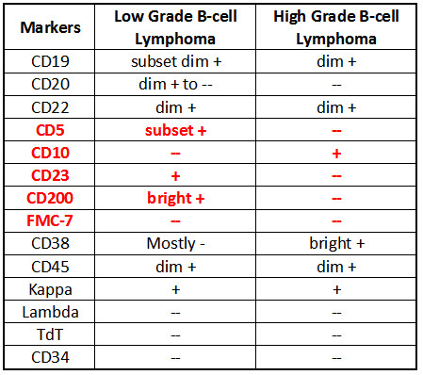
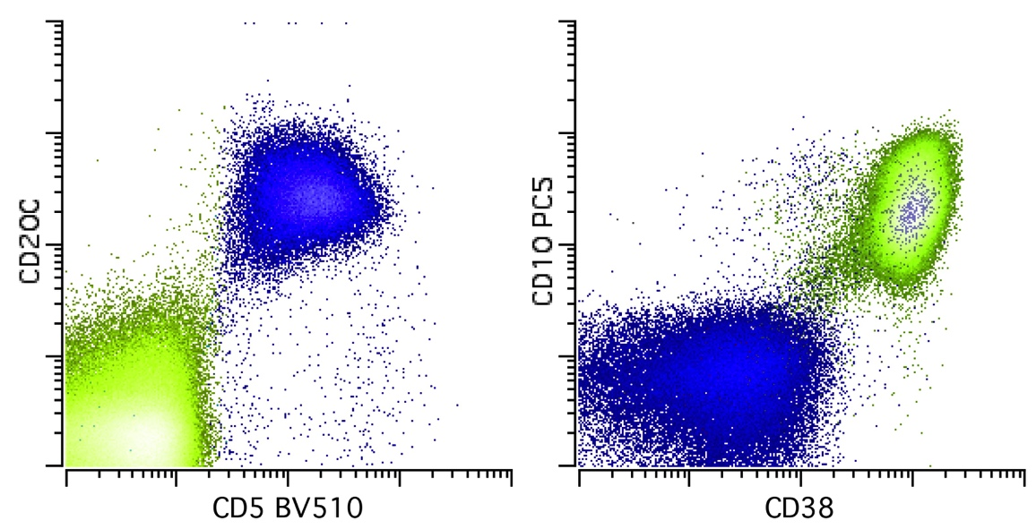
Immunophenotype
BM aspirate, gated on CD19 positive B cells

Slide 6
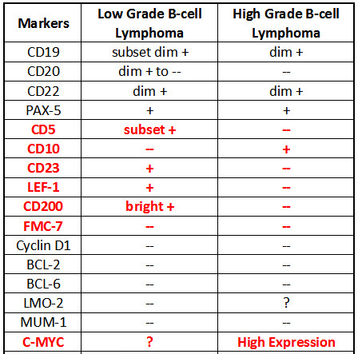
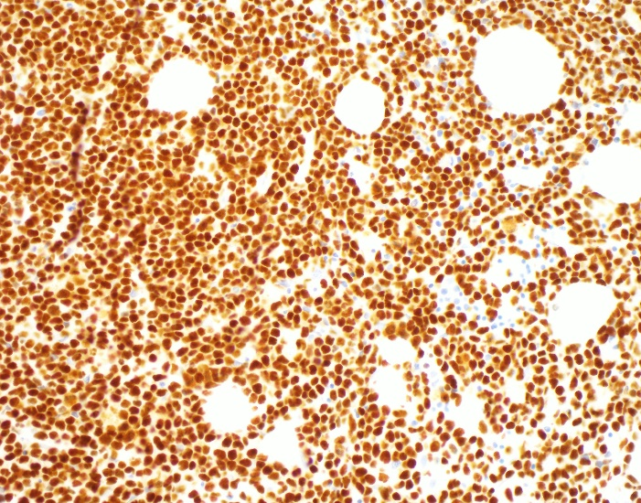
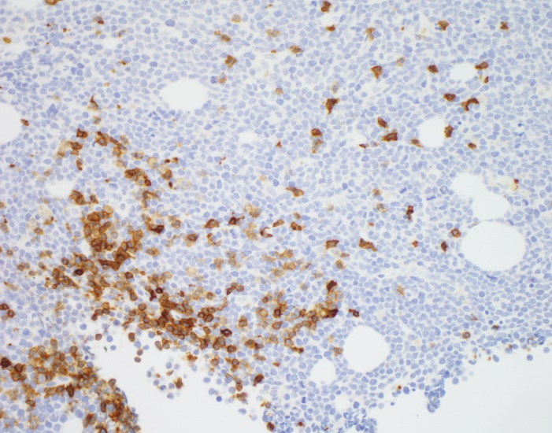
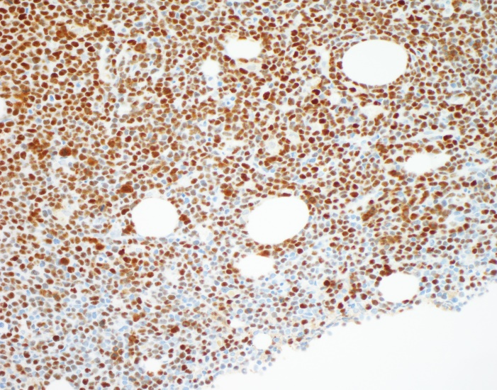
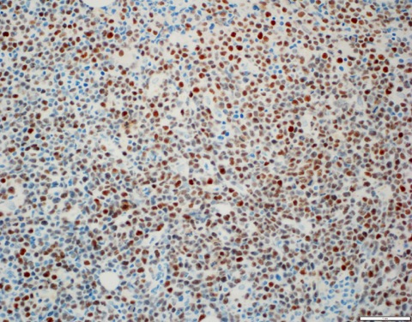
Immunophenotype-cont’d
PAX5 x400
CD5 x400
P53 x400
CMYC x400

Slide 7
Cytogenetics-FISH on flow sorted CLL vs HGBCL populations
CD5+ CLL/SLL – Loss of TP53 in 85% cells
CD10+ HGBCL– No loss of TP53
RED: TP53 (17p13) probe, GREEN: CEP17 probe

Slide 8
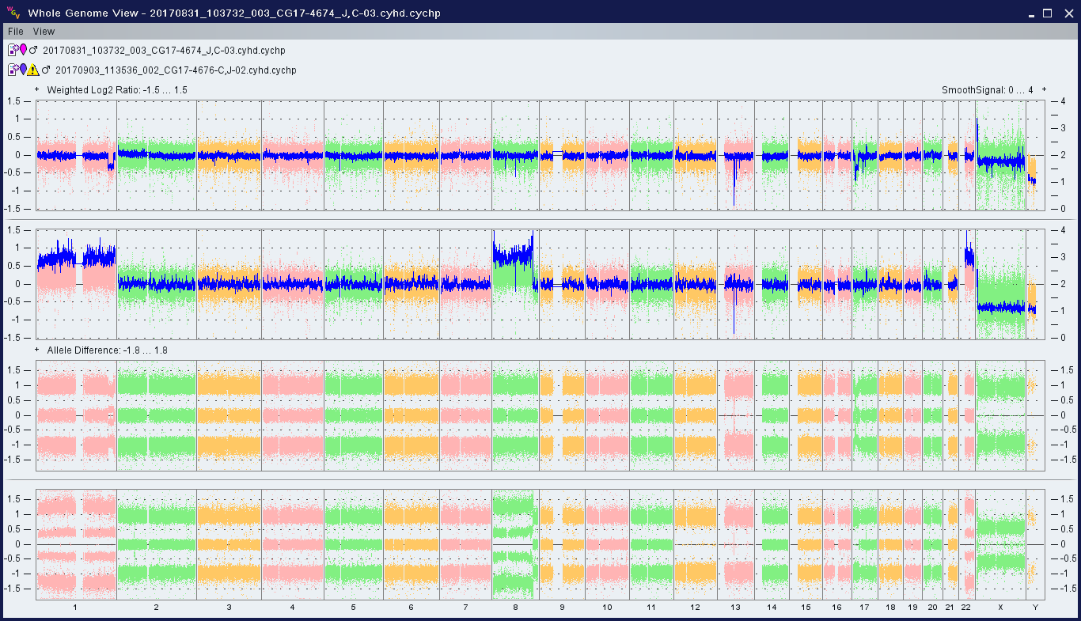
Cytogenetics-SNP array on flow sorted CLL vs HGBCL populations
Shared 13q14.2 – Hemizygous deletion for RB1 and homozygous deletion for SETDB2
Differential 17p aberrations btw CLL and HGBCL
CLL
HGBCL
CLL
HGBCL

Slide 9
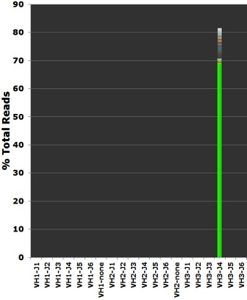
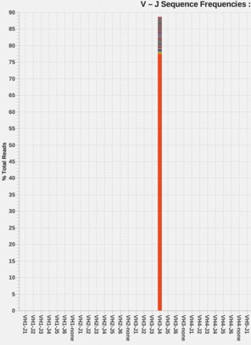
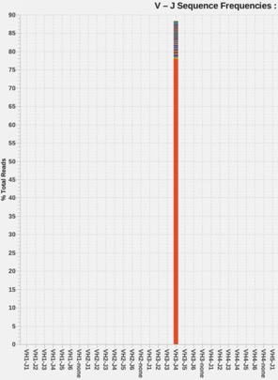
Molecular Studies-IGHV Gene rearrangement studies by NGS method on Flow cytometry-sorted and unsorted blood samples
Unsorted Sample
Sorted CD5+ CLL/SLL
Sorted CD10+ HGBCL
Single, identical clonal sequence detected in all 3 samples using IGHV FR1 primer for PCR amplification (not shown) and NGS sequencing method

Slide 10
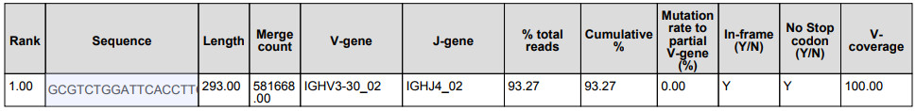
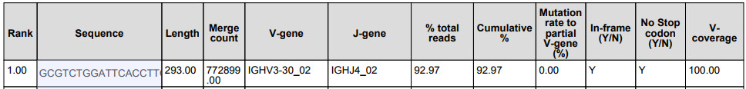
Molecular-cont’d
CD5+ CLL/SLL
CD10+ HGBCL
Single, identical clonal sequence detected
293bp PCR amplification product using FR1 primers
IGHV-J usage of V3-30 J4
0.0% IGHV mutation frequency (unmutated)

Slide 11
Molecular-Targeted Mutation Detection by NGS Method on Unsorted blood sample
Targeted Mutation detection in 49 genes by amplicon capture-based NGS method (No germline variant filtering) show:
1. SF3B1 (NM_012433) exon14 p.K666E (c.1996A>G), VAF= 38.0%
2. TP53 (NM_000546) exon7 p.M237I (c.711G>T), VAF=69.2%
3. TP53 (NM_000546) exon7 p.G244C (c.730G>T), VAF=2.2%*
4. TP53 (NM_000546) exon8 p.E271K (c.811G>A), VAF=5.2%*
5. RAD21 (NM_006265) exon14 p.P616L (c.1847C>T), VAF=46.8%
* Indicates variants are likely subclonal in nature

Slide 12
Proposed Diagnosis/ses
Bone marrow involvement by chronic lymphocytic leukemia/small lymphocytic lymphoma (CLL/SLL), and high grade B-cell lymphoma (HGBCL) with MYC gene rearrangement, clonally related

Slide 13
Interesting Features of Case
The CLL/SLL and HGBCL have a different immunophenotypic profile
Nevertheless, they are clonally-related by IGH gene rearrangement analysis
Also, both share alterations in RB1, SETDB2, and TP53 genes by SNP array analysis
Based on the two tumors’ clonal relationship yet markedly different immunophenotypic profile and differential aberrations of SNP array findings, we believe that this is NOT a linear evolution of CLL/SLL with Richter’s transformation
Rather, we hypothesize that there was a common clonal progenitor with branching evolution into the two different tumors at different time points.

